Slide 1
Programming Machine Learning Applications
Lecture Five: Text Categorization & Recommender Systems
Dr. Aleksandar Velkoski

Slide 2
Review of Lecture Four
Classification
Numeric Prediction
Bayes
Decision Trees

Slide 3
Lecture Five
Text Classification
Recommender Systems

Slide 4
Recommender Systems

Slide 5
Predictive User Modeling
The Problem
Dynamically serve customized content (ads, products, deals, recommendations, etc.) to users based on their profiles, preferences, or expected needs
Example: Recommender systems
Personalized information filtering systems that present items (films, television, video, music, books, news, restaurants, images, web pages, etc.) that are likely to be of interest to a given user

Slide 6
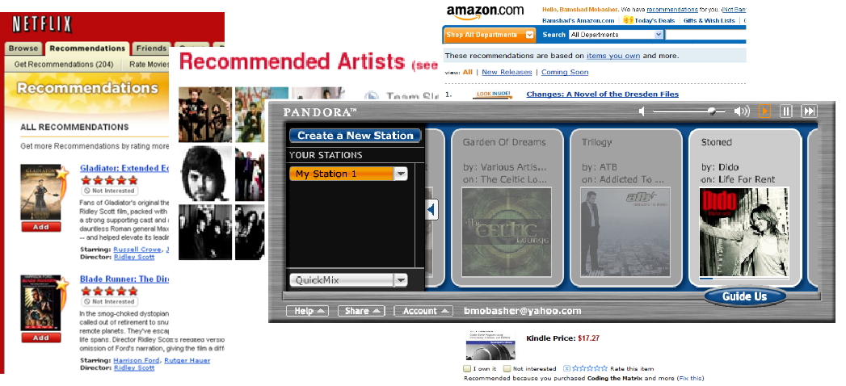
Why we need it?
For businesses: grow customer loyalty / increase sales
Amazon 35% of sales from recommendation; increasing fast!
Netflix 40%+ of movie selections from recommendation
Facebook 90% of user interactions via personalized feeds

Slide 7
Common Approaches
Collaborative Filtering
Give recommendations to a user based on preferences of “similar” users
Preferences on items may be explicit or implicit
Includes recommendation based on social / collaborative content
Content-Based Filtering
Give recommendations to a user based on items with “similar” content in the user’s profile
Rule-Based (Knowledge-Based) Filtering
Provide recommendations to users based on predefined (or learned) rules
age(x, 25-35) and income(x, 70-100K) and children(x, >=3) recommend(x, Minivan)
Hybrid Approaches

Slide 8
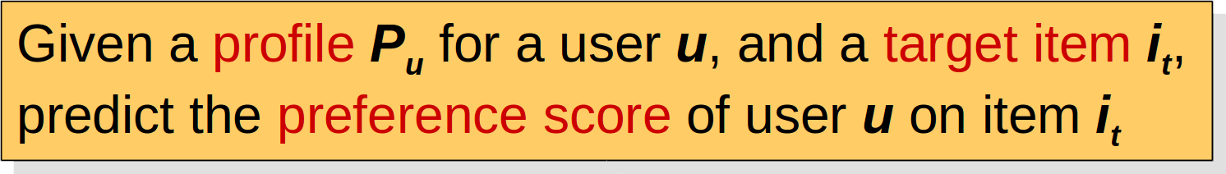
The Recommendation Task
Basic formulation as a prediction problem
Typically, the profile Pu contains preference scores by u on some other items, {i1, …, ik} different from it
preference scores on i1, …, ik may have been obtained explicitly (e.g., movie ratings) or implicitly (e.g., time spent on a product page or a news article)

Slide 9
Recommendation as Rating Prediction
Two types of entities: Users and Items
Utility of item i for user u is represented by some rating r (where r ∈ Rating)
Each user typically rates a subset of items
Recommender system then tries to estimate/predict the unknown ratings, i.e., to extrapolate rating function Rec based on the known ratings:
Rec: Users × Items → Rating
i.e., two-dimensional recommendation framework
The recommendations to each user are made by offering his/her highest-rated items

Slide 10
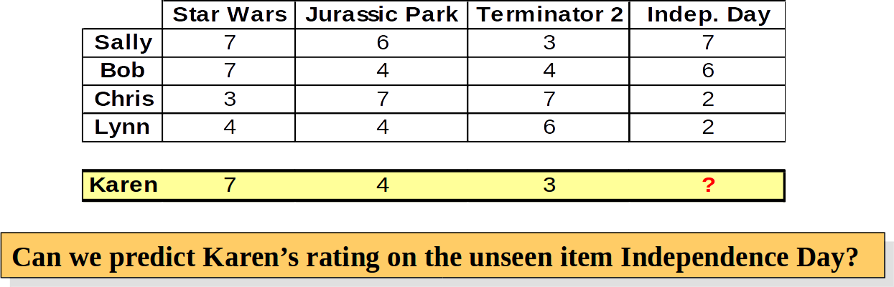
Collaborative Recommender Systems
Collaborative filtering recommenders
Predictions for unseen (target) items are computed based the other users’ with similar interest scores on items in user u’s profile
i.e. users with similar tastes (aka “nearest neighbors”)
requires computing correlations between user u and other users according to interest scores or ratings
k-nearest-neighbor (knn) strategy

Slide 11
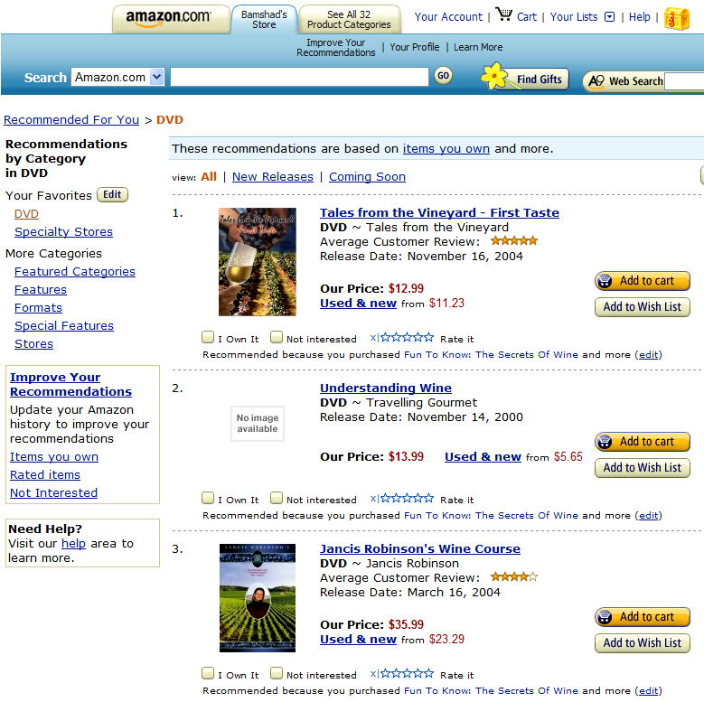

Slide 12
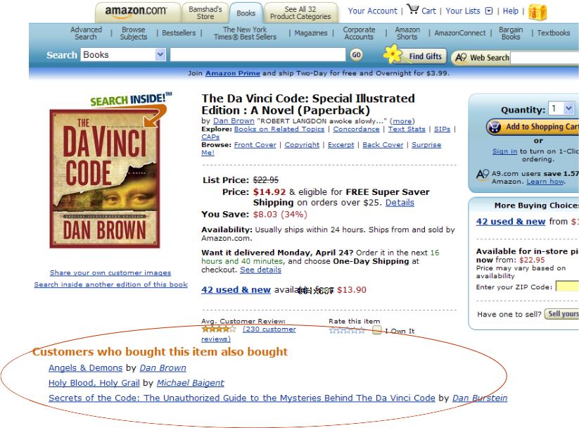

Slide 13


Slide 14
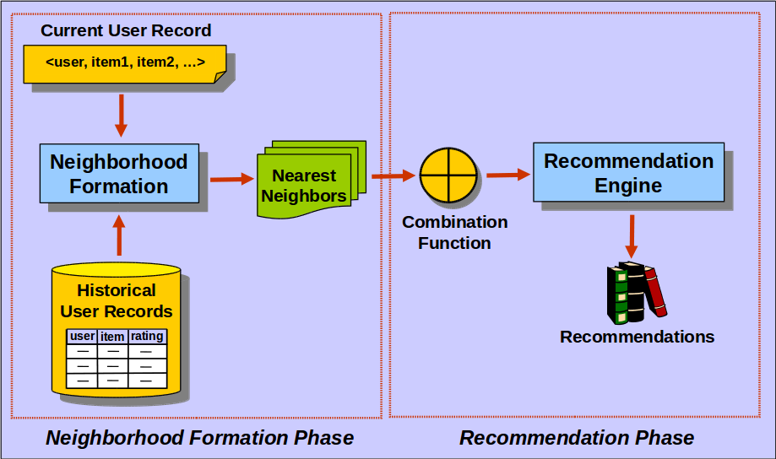
Basic Collaborative Filtering Process

Slide 15
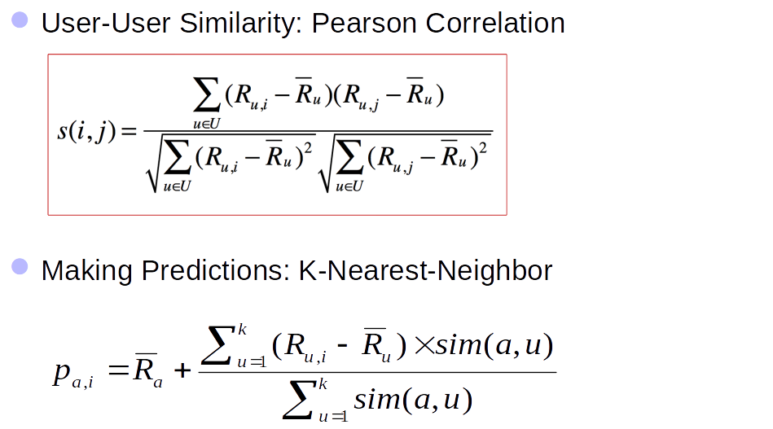
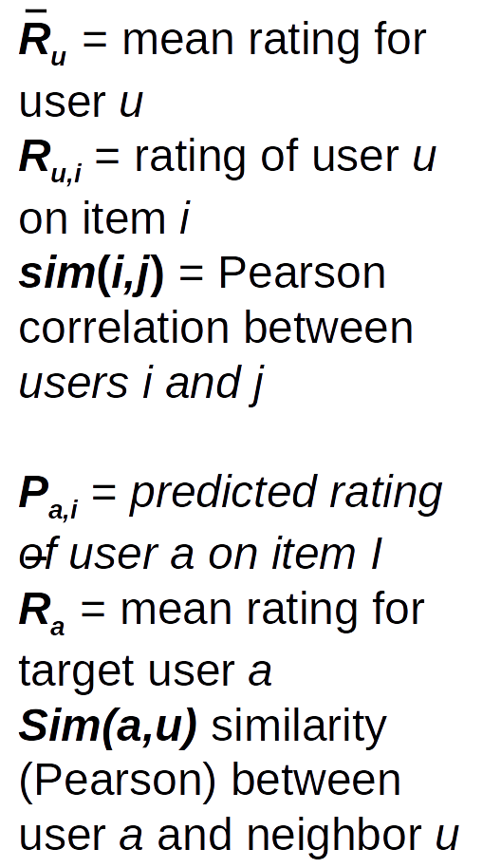
User Based Collaborative Filtering

Slide 16
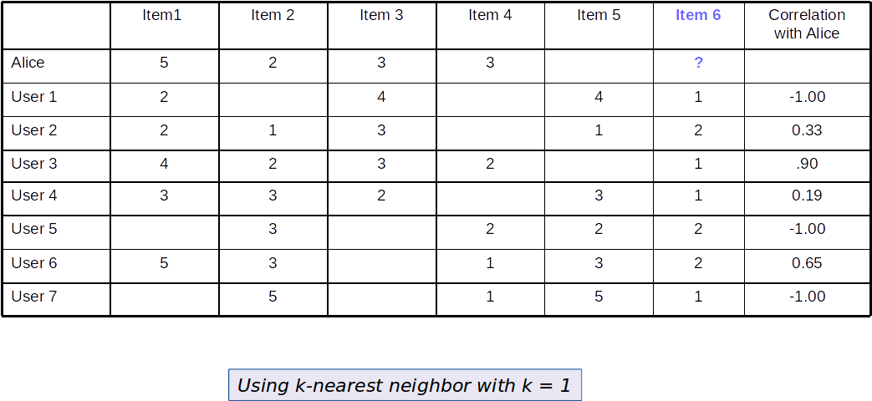
Example

Slide 17
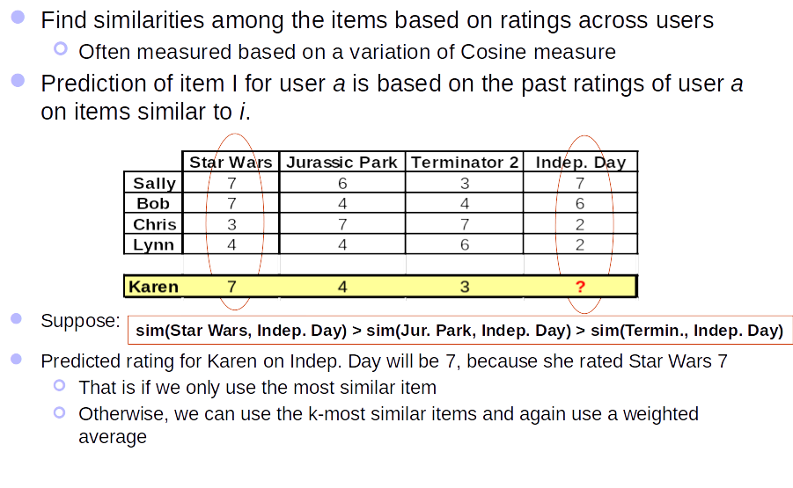
Item Based Collaborative Filtering

Slide 18
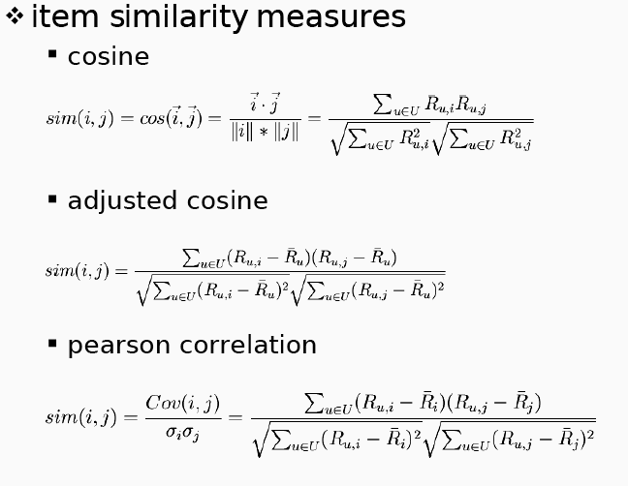
Item Based Collaborative Filtering
(Items & Ratings as vectors)
(Adjusted for different user rating schemes)
(How much ratings deviate from average)

Slide 19
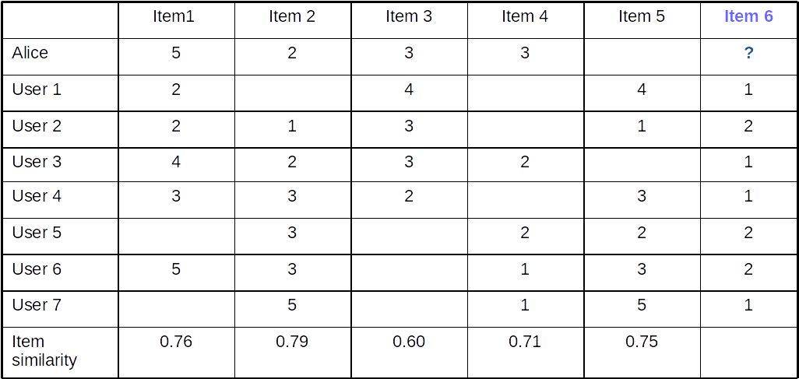
Example

Slide 20
Evaluation
Split users into train/test sets
For each user a in the test set:
split a’s votes into observed (I) and to-predict (P)
measure average absolute deviation between predicted and actual votes in P
MAE = mean absolute error
Or RMSE = root mean squared error
Average over all test users

Slide 21
Data Sparsity Problems
Cold start problem
How to recommend new items? What to recommend to new users?
Straightforward approaches
Ask/force users to rate a set of items
Use another method (e.g., content-based, demographic or simply non-personalized) in the initial phase
Alternatives
Use better algorithms (beyond nearest-neighbor approaches)
In nearest-neighbor approaches, the set of sufficiently similar neighbors might be too small to make good predictions
Use model-based approaches (clustering; dimensionality reduction, etc.)

Slide 22
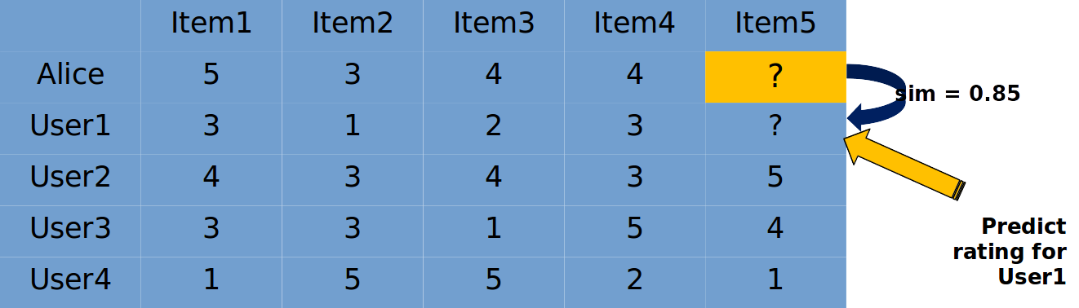
Example Algorithms for Sparsity
Recursive CF
Assume there is a very close neighbor n of u who has not yet rated the target item i .
Apply CF-method recursively and predict a rating for item i for the neighbor
Use this predicted rating instead of the rating of a more distant direct neighbor

Slide 23
Model Based Approaches
Matrix factorization techniques, statistics
singular value decomposition, principal component analysis
Approaches based on clustering
Association rule mining
compare: shopping basket analysis
Probabilistic models
clustering models, Bayesian networks, probabilistic Latent Semantic Analysis
Various other machine learning approaches

Slide 24
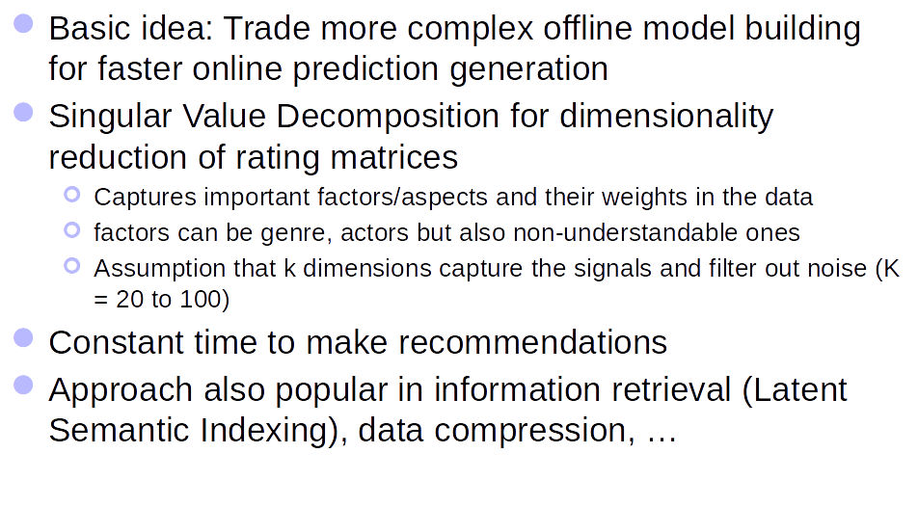
Dimensional Reduction

Slide 25
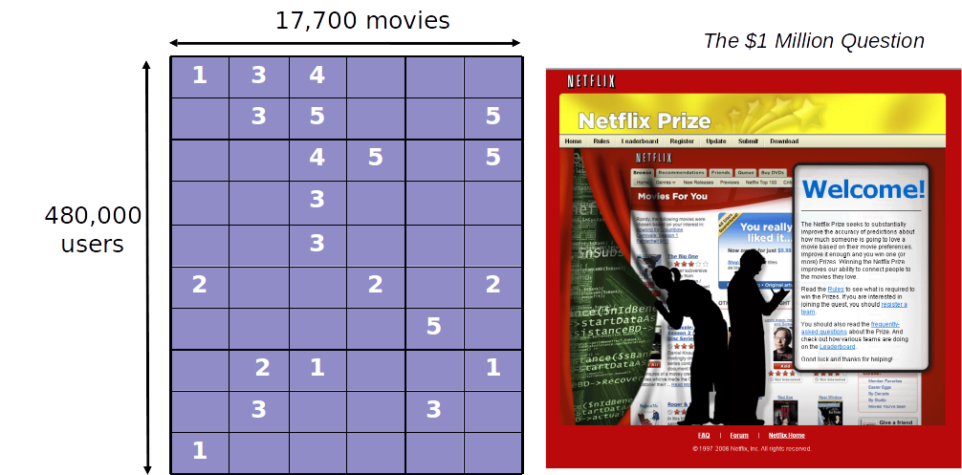
Netflix Prize

Slide 26
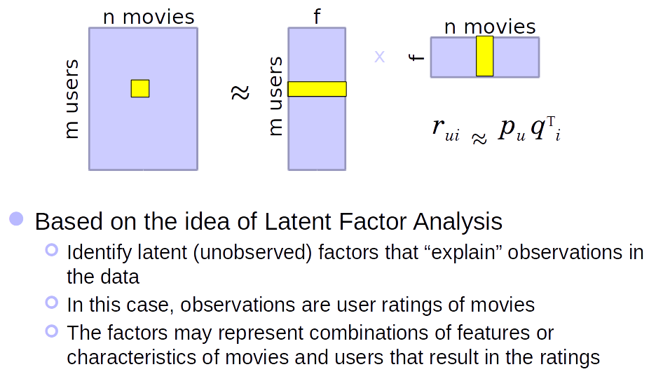
Matrix Factorization of Ratings Data

Slide 27
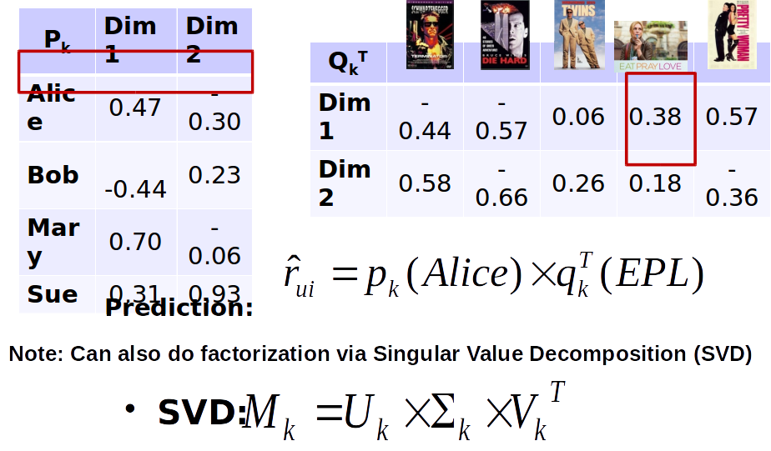
Matrix Factorization

Slide 28
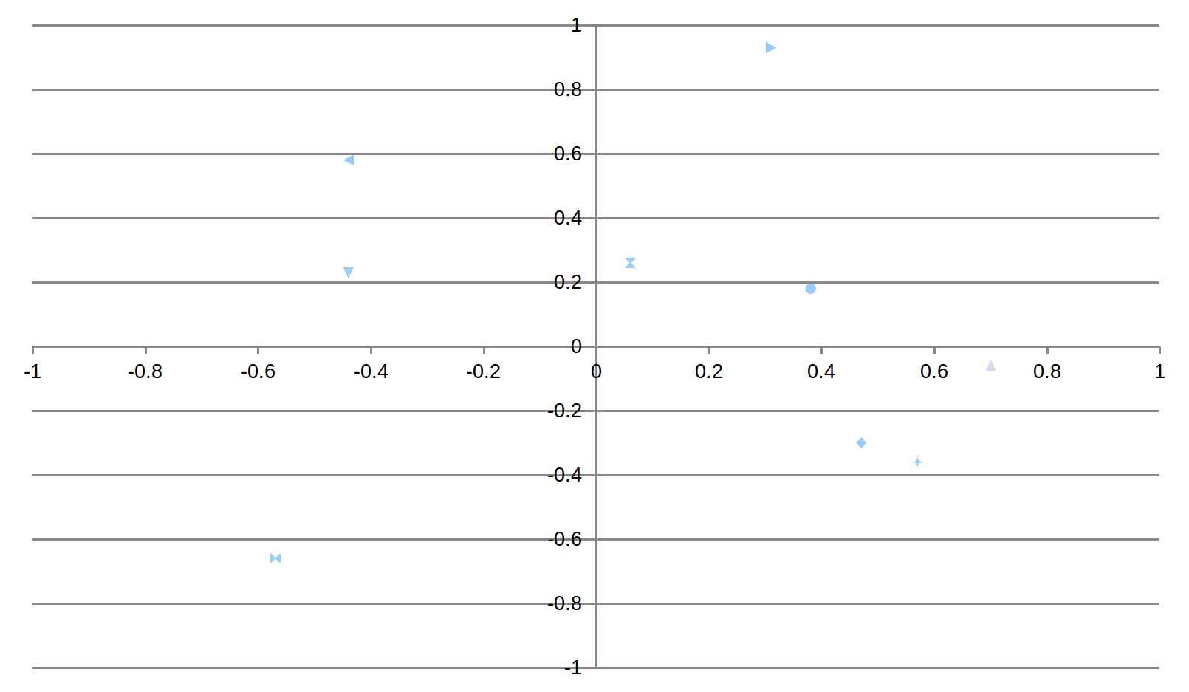
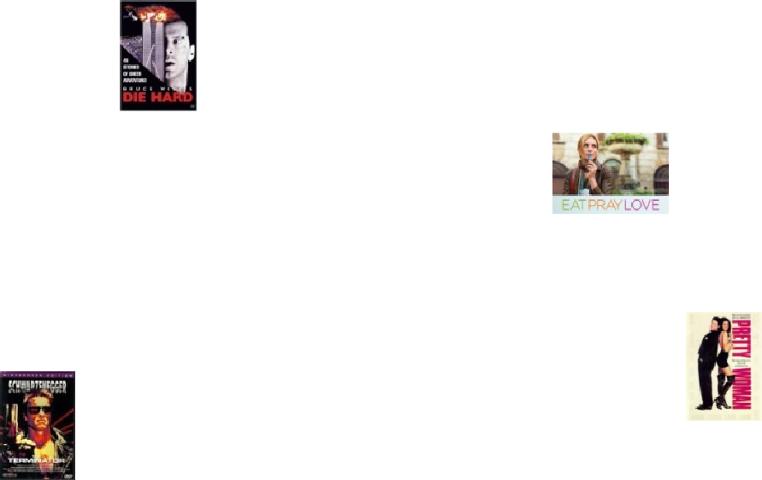
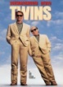
Lower Dimensional Feature Space

Slide 29
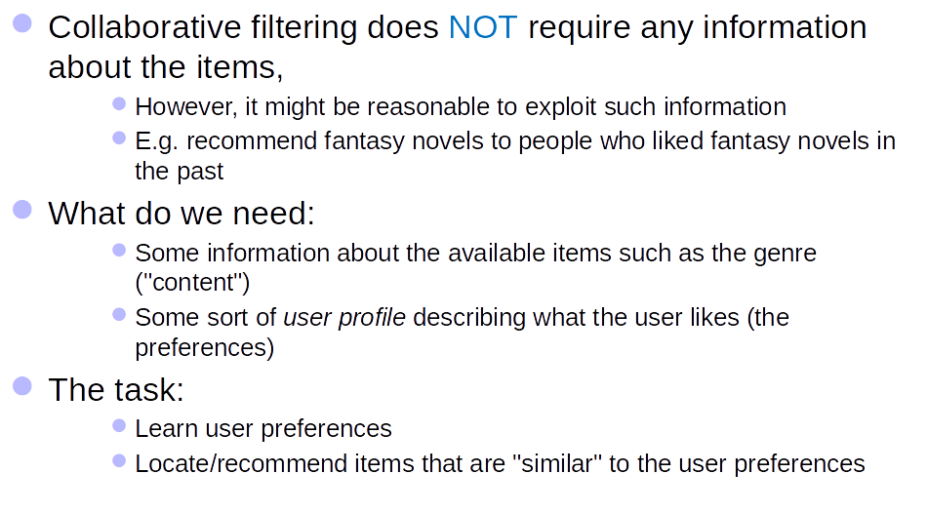
Content Based Recommendations

Slide 30
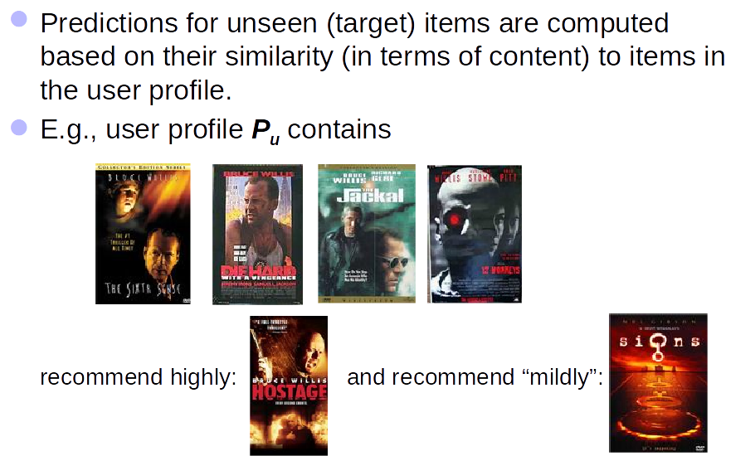
Content Based Recommendations

Slide 31
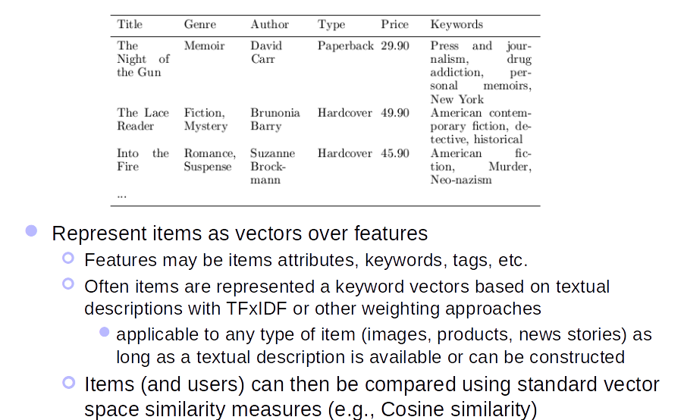
Content Representation

Slide 32
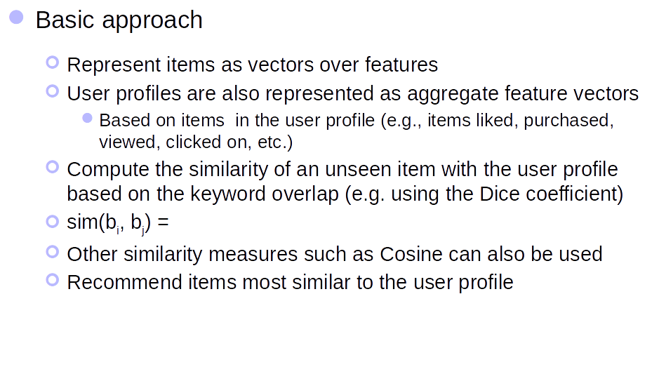
Content Based Recommendation

Slide 33
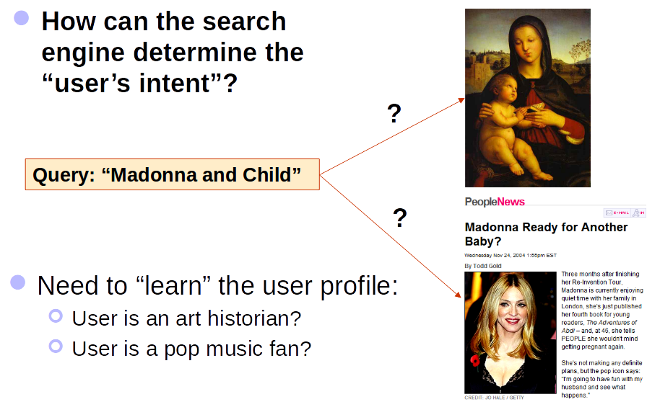
Personalized Search

Slide 34
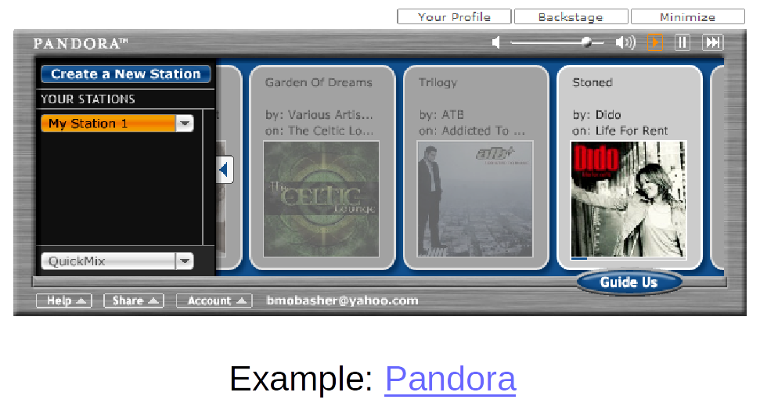
Example

Slide 35
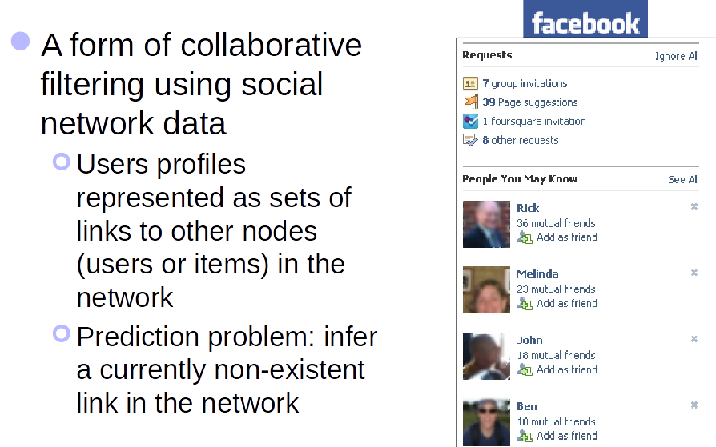
Social Recommendation

Slide 36
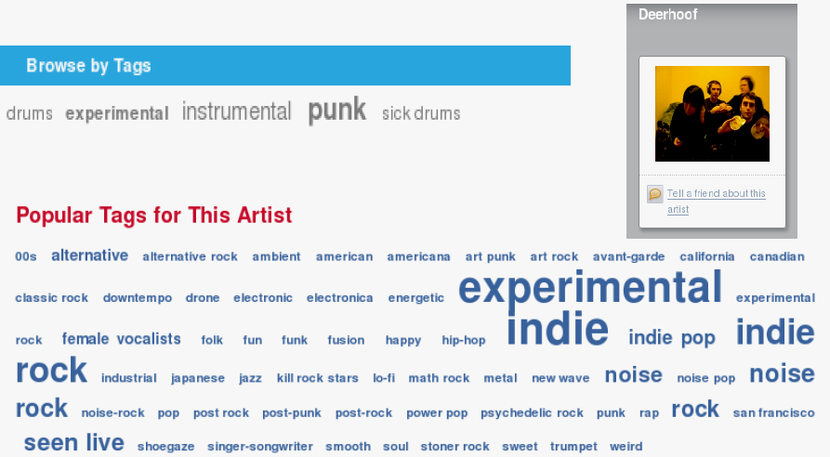
Social / Collaborative Tags

Slide 37
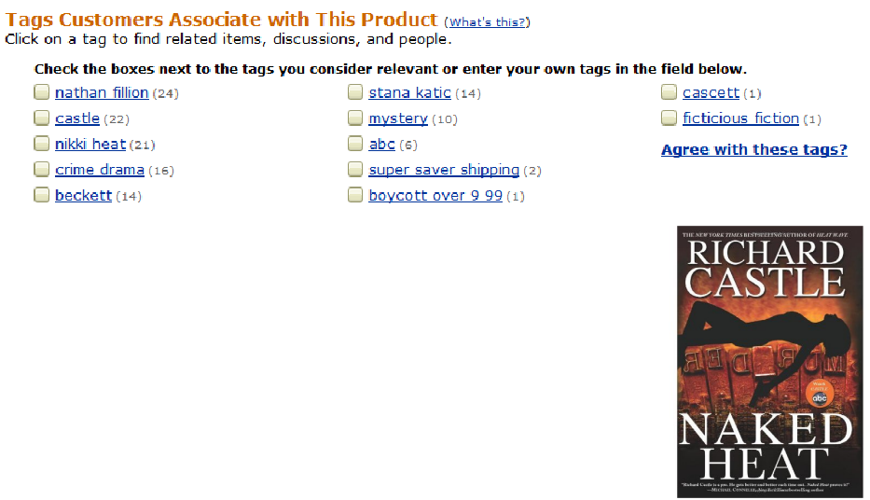
Example Tags Describe the Resource
Tags can describe
The resource (genre, actors, etc)
Organizational (toRead)
Subjective (awesome)
Ownership (abc)
etc

Slide 38
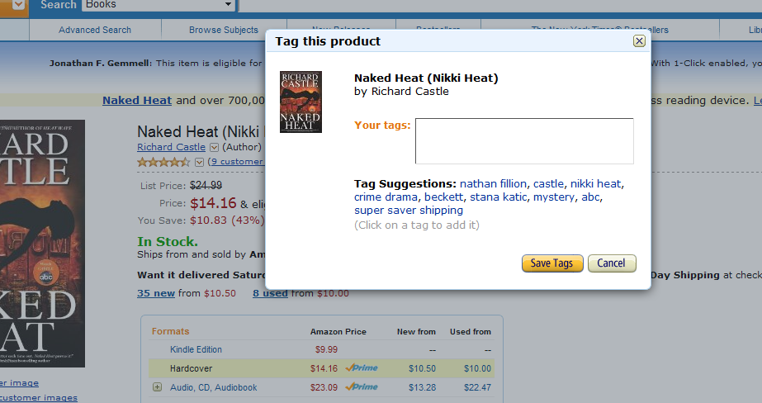
Tag Recommendation

Slide 39
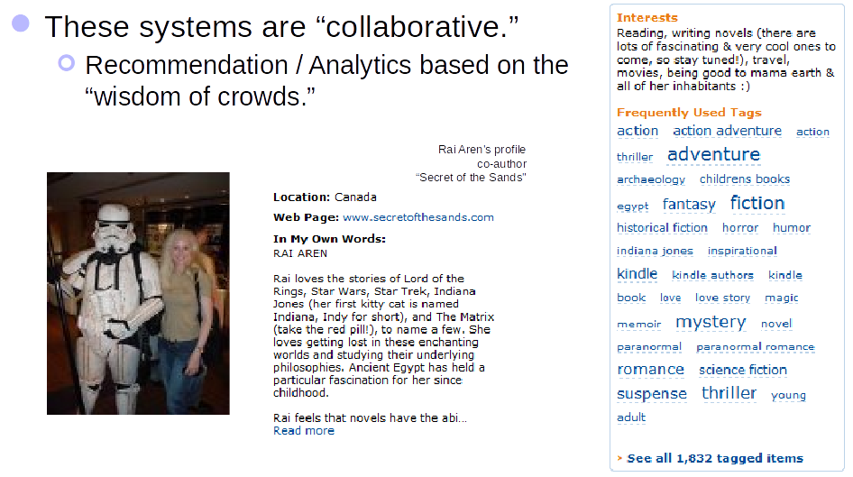
Tags Describe the User

Slide 40
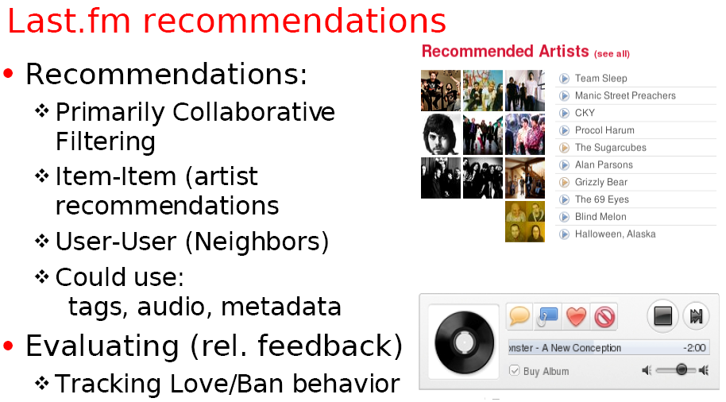
Using Tags for Recommendation

Slide 41
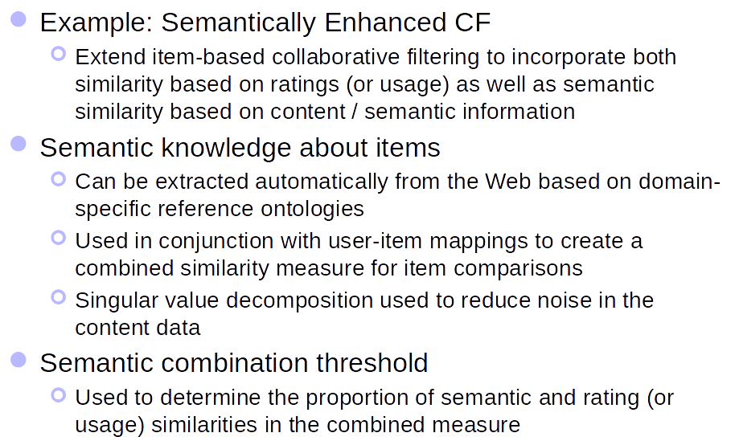
Combining Content and Collaborative Recommendation

Slide 42
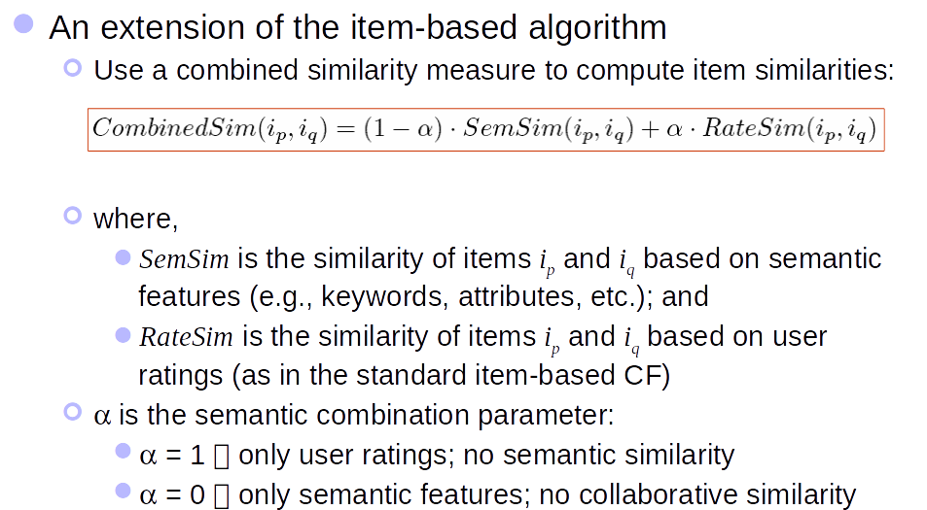
Semantically Enhanced Hybrid Recommendation

Slide 43
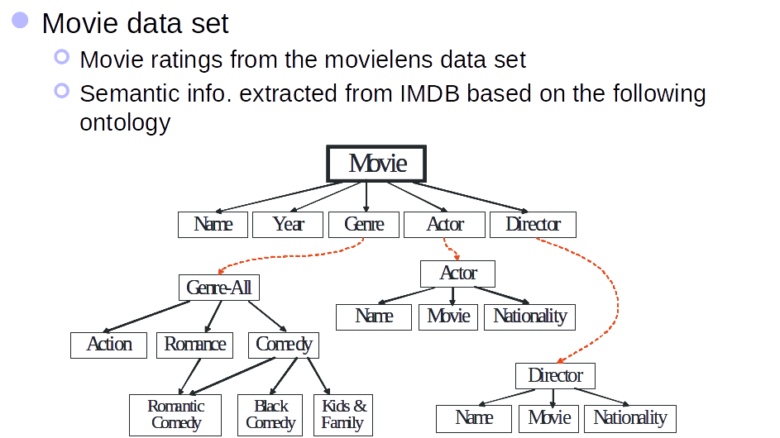
Semantically Enhanced CF

Slide 44
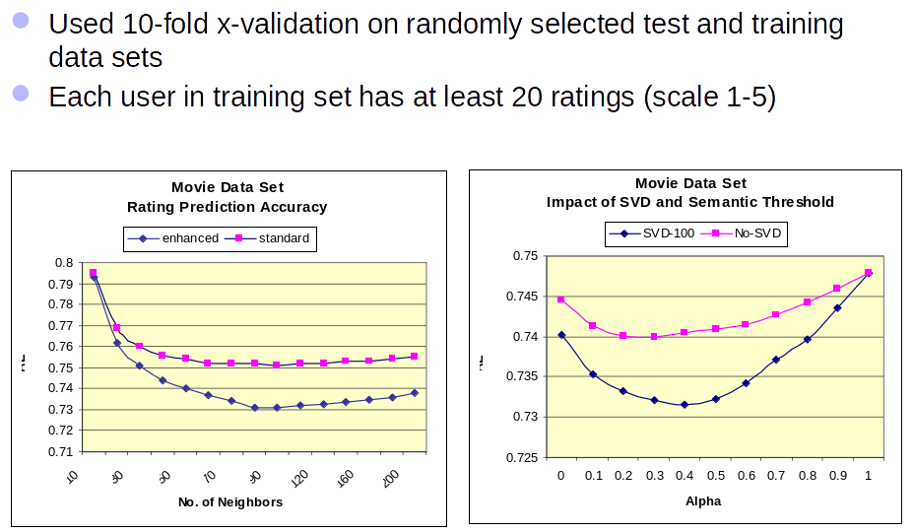
Semantically Enhanced CF

Slide 45
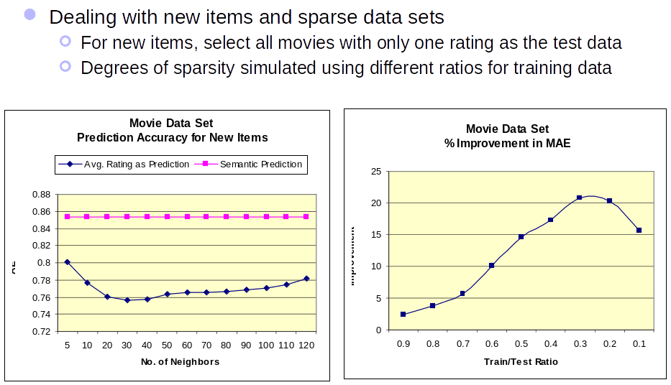
Semantically Enhanced CF

Slide 46
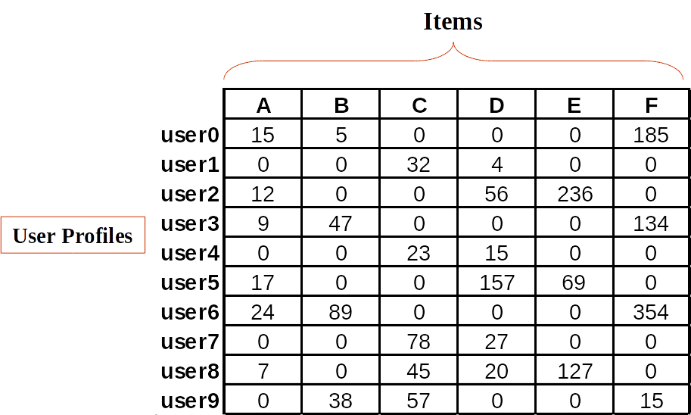
Representation of User Profile Data

Slide 47
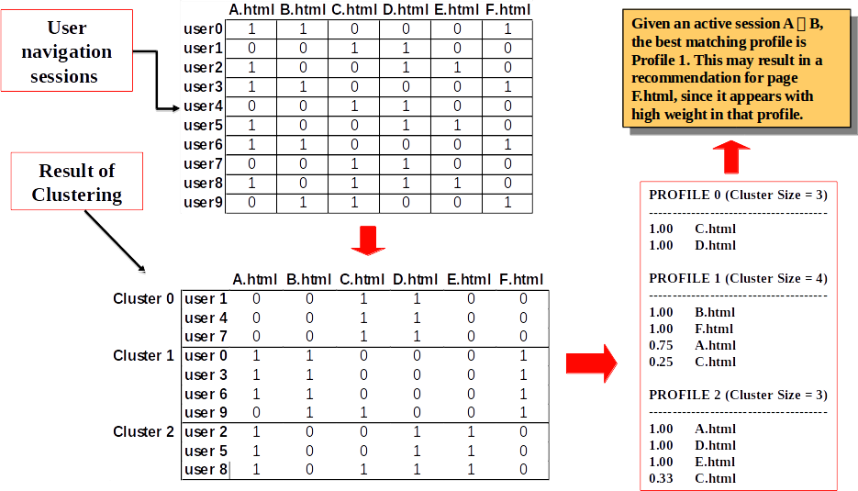
Using Clusters for Web Personalization

Slide 48
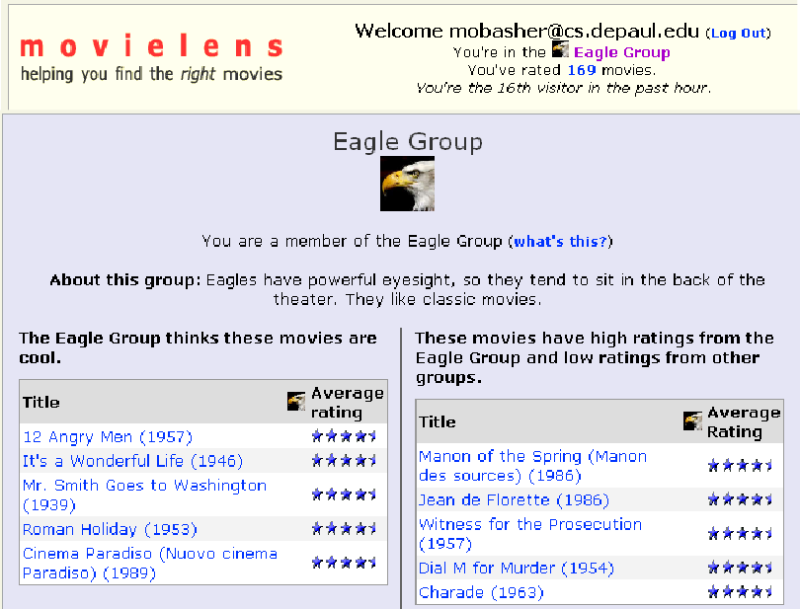
Clustering and Collaborative Filtering

Slide 49
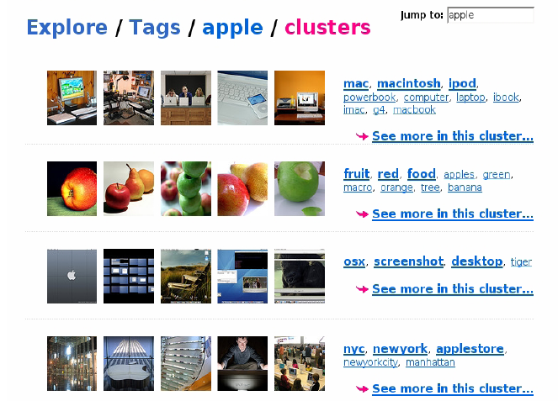
Tag Clustering

Slide 50
Questions
Wrapping-up the Lecture

Slide 51
What is the difference tf idf?

Slide 52
What is the intuition of tf x idf?

Slide 53
How do you evaluate the performance of recommender systems?

